Slide 1
From last week
Interpreting regression coefficients
Unstandardized, standardized
Odds ratios
“exponentiate”
2 = twice as likely
1.5 = 50% more likely
0.5 = 50% less likely

Slide 2
Mediation and Moderation
Jamil Bhanji
with help from Vanessa Lobue and Andy Field

Slide 3
Mediation and Moderation
Most of the time we ask whether x affects y (or relates to y)
Moderation analysis asks when/for whom x exerts its affect on y (or relates to y)
Mediation analysis asks how/why x exerts its affect on y (a causal chain is implied)
This is also called conditional process analysis

Slide 4
A note on causality
“Although data analysis can’t be used to demonstrate or prove causal claims, it can be used to determine if the data are consistent with a proposed causal process.” (Hayes, pg 27)
Causal claims are independent of the math you use; they are situated with caveats about the nature of the data

Slide 5
Moderation
The combined effect of two variables on another is known conceptually as moderation, and in statistical terms as an interaction effect.
Moderation answers the “when” and “for whom” two variables become associated

Slide 6
Example
Do violent video games make people antisocial?
Participants
442 youths
Variables
Aggression
Callous unemotional traits
Number of hours spent playing video games per week

Slide 7
Conceptual Moderation Model
If callous-unemotional traits were a moderator then we’re saying that the strength or direction of the relationship between game playing and aggression is affected by callous-unemotional traits.

Slide 9
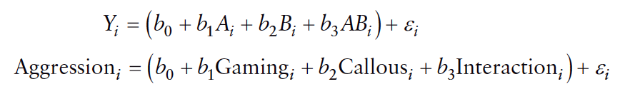
The Statistical Moderation Model

Slide 10
Centering Variables
The interaction term makes the bs for the main predictors uninterpretable in many situations.
For this reason, it is common to transform the predictors using grand mean centering.
Centering refers to the process of transforming a variable into deviations around a fixed point.

Slide 11
Mediation
Refers to a situation when the relationship between a predictor variable and outcome variable can be explained by their relationship to a third variable (the mediator).
Mediation answers the “how” two variables become associated
**Mediation is a causal process which requires establishing the cause and effect relation over time

Slide 12
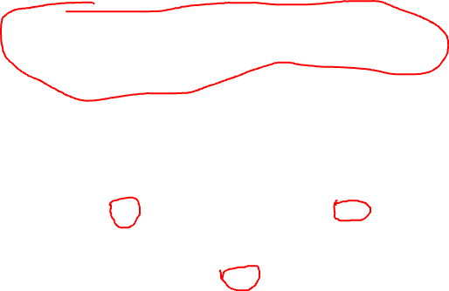
The Statistical Model

Slide 13
Example of Mediation Model
Maternal Anxiety
Infant Emotion
Perception

Slide 14
Example of Mediation Model
Emotional Input
Maternal Anxiety
Infant Emotion
Perception

Slide 15
Example of Mediation Model
Emotional Input
8 mos
Maternal Anxiety
6 mos
Infant Emotion
Perception
12 mos

Slide 16

Baron & Kenny, (1986)
Mediation is tested through three regression models:
Predicting the outcome from the predictor variable.

Slide 17
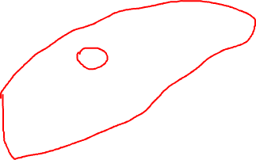
Baron & Kenny, (1986)
Mediation is tested through three regression models:
Predicting the outcome from the predictor variable.
Predicting the mediator from the predictor variable.

Slide 18
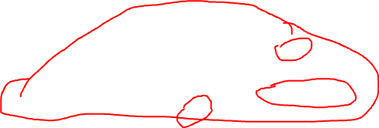
Baron & Kenny, (1986)
Mediation is tested through three regression models:
Predicting the outcome from the predictor variable.
Predicting the mediator from the predictor variable.
Predicting the outcome from both the predictor variable and the mediator.

Slide 19
Baron & Kenny, (1986)
Four conditions of mediation:
1. The predictor must significantly predict the outcome variable.

Slide 20
Baron & Kenny, (1986)
Four conditions of mediation:
outcome variable.
2. The predictor must significantly predict the mediator.

Slide 21
Baron & Kenny, (1986)
Four conditions of mediation:
3. The mediator must significantly predict the outcome variable.

Slide 22

Baron & Kenny, (1986)
Four conditions of mediation:
4. The predictor variable must predict the outcome variable less strongly in model 3 than in model 1.

Slide 23
Baron & Kenny, (1986)
Four conditions of mediation:
4. The predictor variable must predict the outcome variable less strongly in model 3 than in model 1.

Slide 24
Limitations of Baron & Kenny’s (1986) approach
How much of a reduction in the relationship between the predictor and outcome is necessary to infer mediation?
people tend to look for a change in significance, which can lead to the ‘all or nothing’ thinking that p-values encourage (Field)
Never a good idea to run multiple significance tests
This approach only tells you if there is a significant mediation, not how large (Hayes)

Slide 25
Sobel Test (Sobel, 1982)
An alternative is to estimate the indirect effect and its significance using the Sobel test (Sobel, 1982).
If the Sobel test is significant, there is significant mediation.
Significance tests depend upon sample size.

Slide 26
PROCESS
Will give you strength of both your direct (predictor) and indirect (mediator effects)
That’s what you did …

Slide 27
From Fairchild & McDaniel (2017): Best (but oft-forgotten) practices: mediation analysis. The American Journal of Clinical Nutrition,https://doi.org/10.3945/ajcn.117.152546 “cross-sectional sample data can indicate support for mediation effects when there is no true mediation process in the population (92). These findings are not to say that it is impossible to examine mediation hypotheses with data that are collected at one point in time; however, there is an onus on the researcher to provide a compelling rationale that temporal ordering of the examined variables is correct (93, 94). Indeed, Kenny and colleagues (10, 11) emphasized in early work that mediation analysis should not be conducted unless the temporal ordering of the variables is clear. Examining mediation hypotheses with cross-sectional data may be reasonable, for example, if measured variables can reflect nearly instantaneous processes, such as may be the case with some pharmacokinetics work, or imply timing by nature of their construction (18, 93). Consider a research scenario in which the mediating role of parental food monitoring during an individual’s adolescence (M) is posited to explain the impact of parental childhood obesity (X) on subjects’ current obesity status (Y). Although one may garner this information from participants at a single measurement occasion, it may be sensible to argue temporal precedence of the variables in a causal chain given the chronological nature of the constructs. Researchers should be mindful of potential retrospective reporting bias in these cases, however.”

